Slide 1
Wellness Wednesday Summer Safety Basics

Slide 2
Agenda
Burns
1st, 2nd, and 3rd degree
Sprains and Strains
Stings and Bites
Allergic reaction
Seizure
Dehydration
Heat Related Injuries
Notes:
Read the slide

Slide 3
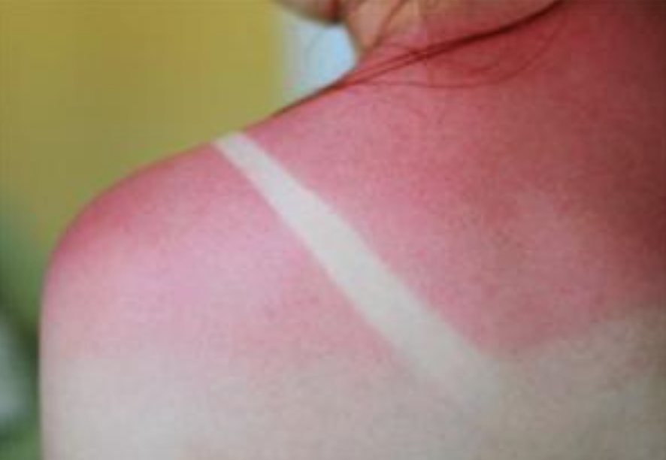
Burns
1st degree, or superficial
Skin appears red, feels warm, and dry to the touch.
Sunburn is common example.
Treatment
Cool the burn by immersing in cool tap water, or apply a cold wet compress for several minutes.
Consider applying over-the-counter burn ointments.
Consider taking over-the-counter pain medications.
Protect the area from sun.
Notes:
1st degree burns, or superficial burns, the skin appears red and, when pressed, the skin of the first degree burn tends to blanch, or turn pale for a moment, after a few moments skin will return to its red color.
Avoid generational, unproven advice passed down from lore. Butter or other substances may cause more harm than good.
Discomfort from these burns lasts about 48 hours, and you should expect peeling in 3-7 days.
While all 1st degree burns aren’t from the sun, if it is due to sun, it would be encouraged to use a protective layer of clothing, or sunscreen with an ample amount of SPF protectant next time. Remember, The higher the SPF the greater the protection.

Slide 4
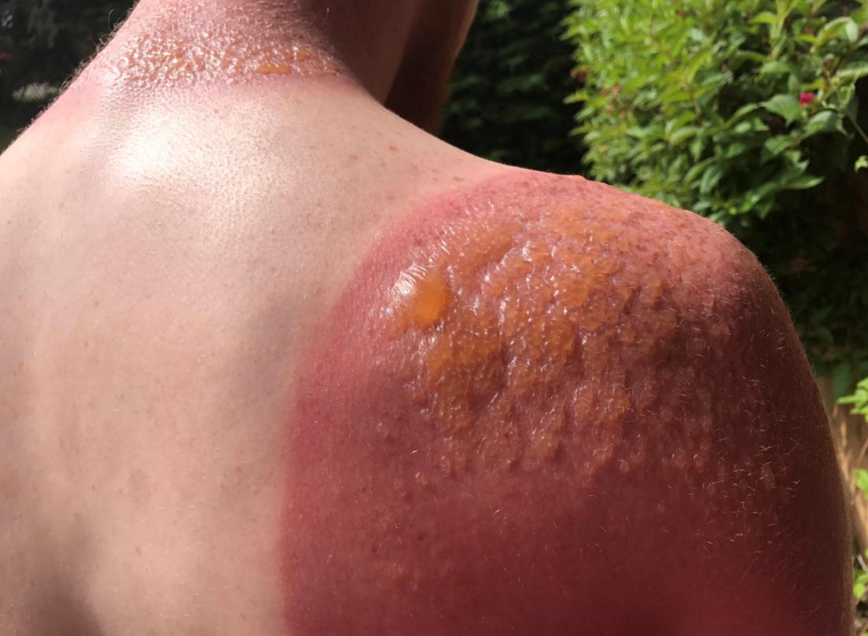
Burns
2nd Degree, or Partial thickness
Skin appears red, blotchy, and blister(s) are present.
Very painful, and often swells.
Treatment
Careful attention as to not break the blisters.
Immerse the affected area in cool water 2-5 minutes.
Cover the burned area with a dry sterile dressing.
Notes:
- 2nd degree burns or partial thickness burns are often surrounded by 1st degree burns. A dry sterile dressing should cover the entire burned area.
Swelling is likely, and careful attention should be taken when wrapping the injury. The dressing should loosely cover over or around the burn. Remove any jewelry or constrictive accessories that may complicate swelling.
If a large area of the skin is affected, consider visiting the emergency room, and avoid using water to cool. Large burn areas can lead to hypothermia, and cool water can make it worse.
For example, a large area would be about 20 percent of the body. Both arms front and back account for 18 percent of body surface area.
If in doubt utilize the burned individuals palm as a measuring guide. Each palm accounts for about 1% of body surface area.
2nd degree burns can take between 14 and 28 days for healing, and healing is dependent on the thickness of the burn.

Slide 5
Burns
3rd degree, or Full Thickness
Skin appears charred, black, brown and cherry red.
Tissue is damaged underneath the skin and may be visible.
Person experiences extreme pain, or little to no pain.
Treatment
STOP THE BURN!
Consider using large amounts of cool water.
Activate EMS.
Cover the patient in a clean, non-fuzzy material (table cloth, or sheet).
Notes:
3rd degree or full thickness burn. Skin appears charred, black, or brown, also cherry red, damaged tissue underneath the skin may be visible, and appear white. Surrounding burns may include 2nd, and 1st degree burns.
Pain levels may vary, dependent on if the nerves endings were damaged, or not. Undamaged nerves are painful, while damaged is painless. Regardless, if painful or not, 3rd degree burns should be treated the same.
Similar to 2nd degree burns, if a large portion of the body is affected 20 percent or greater. Using cool water may increase the likelihood of hypothermia.
3rd degree burns will need help in healing, and will need emergency treatment. Call, or provide transport to Emergency Department ,regardless of the amount of skin damaged.

Slide 6
Burns
Thermal vs Chemical
Thermal is usually due to fire, scalding water, or coming into contact with a hot object.
Chemical burn severity depends on the strength of the substance, and the duration exposed.
Due to the nature of the element, chemical burns should involve EMS despite degree of burn on skin.
Treatment
Liquid chemical burns should be flooded with water until EMS arrives, while solid or powered chemicals should be brushed off prior to the introduction of water.
Notes:
Burns: thermal versus chemical
With thermal burns – Stopping the burn involves removing the affected skin from the causing agent.
With chemical burns – Stopping the burn involves removing the causing agent, from the affected skin. Chemical burns continue to burn until it is removed from skin.
Because chemical burns are more of a workplace hazard, be aware of the chemical you are working with or around, and refer to the Safety Data Sheet, or manufacturers instructions on first-aid treatment.

Slide 7
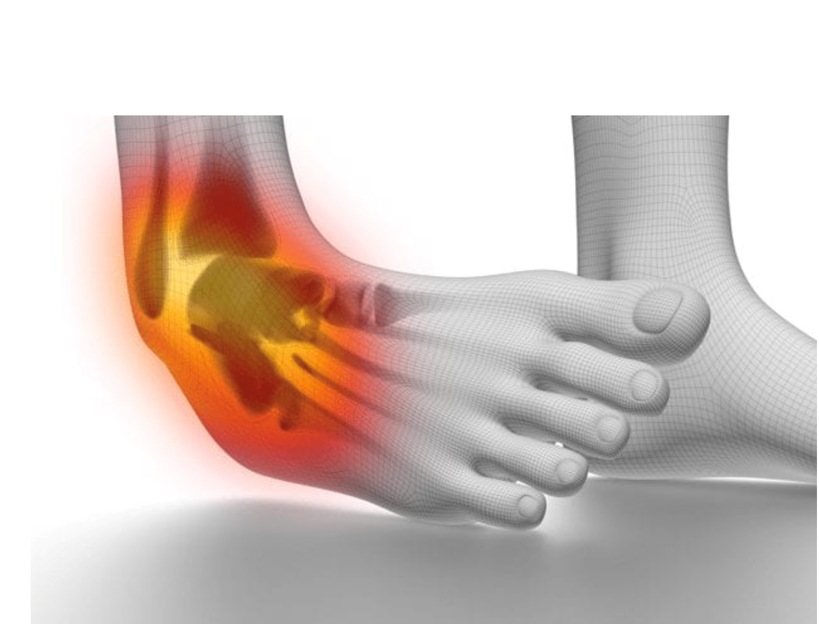
Sprain
Sprains are the injury to connections that join bones together.
Results from a fall, sports injury, or vehicle accident.
Joint appears swollen and discolored while pain is present
Sprains can vary in intensity and are dependent on the amount of damage to the ligament.
Notes:
Sprains are injury's to the connections that join bones together.
The most affected joints include the ankle, knee, wrist and fingers.

Slide 8
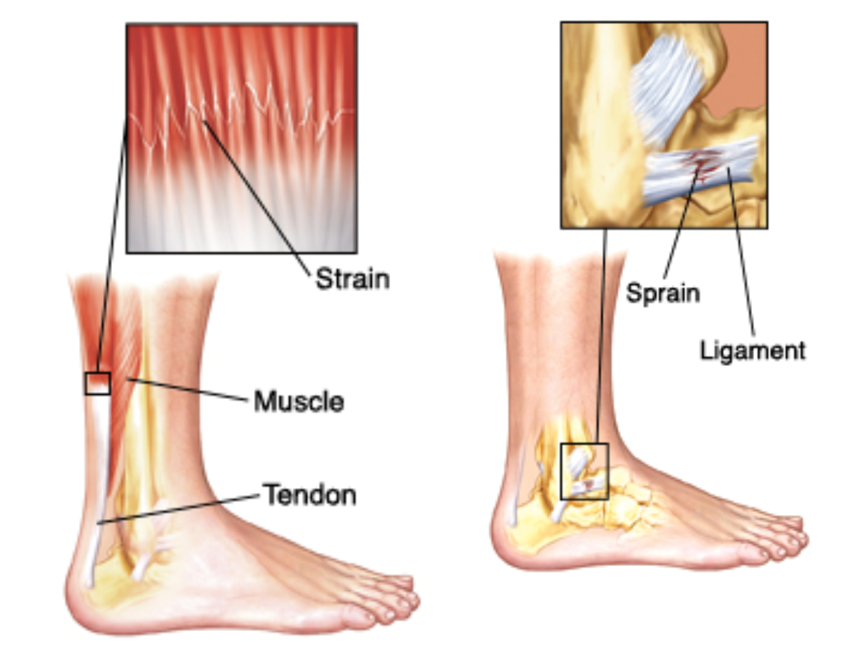
Sprain
Sprain Treatment
Consider applying cold compress
Consider splinting of the injury
Consider elevation
Consider further EMS care
Notes:
Because the difficulty of determining between sprains, dislocations, or fractures, you will need to use you best judgment to render aide. Regardless if it looks and feels serious, then it should be treated in a serious manner.
If you apply a cold compress – apply the pack in short durations, 15-20 minutes followed by an equal amount away from cold. Cold takes away pain and reduces swelling, but too long of a duration and it reverse the affects and increase swelling and increases pain.
- Remember to utilize a protective layer between the cold pack and skin.
If applying a splint- remember to apply the body part in the position you found it. The primary reason for splinting the area is to immobilize it. Remember to not only immobilize the affected area, but also the areas above and below. If the limb is found in an unnatural position, you are most likely dealing with something other than a sprain. Activate emergency procedures.
- Avoid constricting blood flow if applying splint, remember to apply snug not tight.
- Provide padding between the limb and the splint to increase comfort.
Elevating an injury reduces swelling. Remember to consider elevating a splinted injury, and also applying a cold back.

Slide 9
Strain
Strains are the stretching or tearing of muscles or tendons.
Most likely to occur during heavy lifting or overworking a muscle during exercise.
Most Strains are painful and some will appear swollen.
Treatment
Consider applying a cold pack at first.
Consider applying heat later.
Notes:
Strains are the stretching or tearing of muscles or tendons.
-The muscles groups most commonly affected from strains are the neck, back, thigh, and calf.
-Strains generally do not cause the amount of intense pain that comes with fractures, dislocations, and sprains.
Applying a cold pack in short durations tricks the body into thinking it is loosing heat. The body will prevent heat loss by constricting blood vessels. This will in turn limit the accumulation of fluids to body tissue of the affected site, and that’s how cold packs help with swelling.
Applying a heat pad should come secondary to cold, or after some time has passed since the injury has occurred. Not all strains require heat. Similar to cold packs, heat should be used in short durations, 15-30 minutes.
- Heat promotes muscle relaxation, and can be used dilate the blood vessels, and increase oxygen, nutrients, and removal of waste product becomes faster. Using heat in longer periods will have a counter effect, similar to applying cold for too long.
When using hot or cold packs, consider the age of the injured, the location of injury, the possible impairment of sensation, and individual tolerance to temperature change.

Slide 10
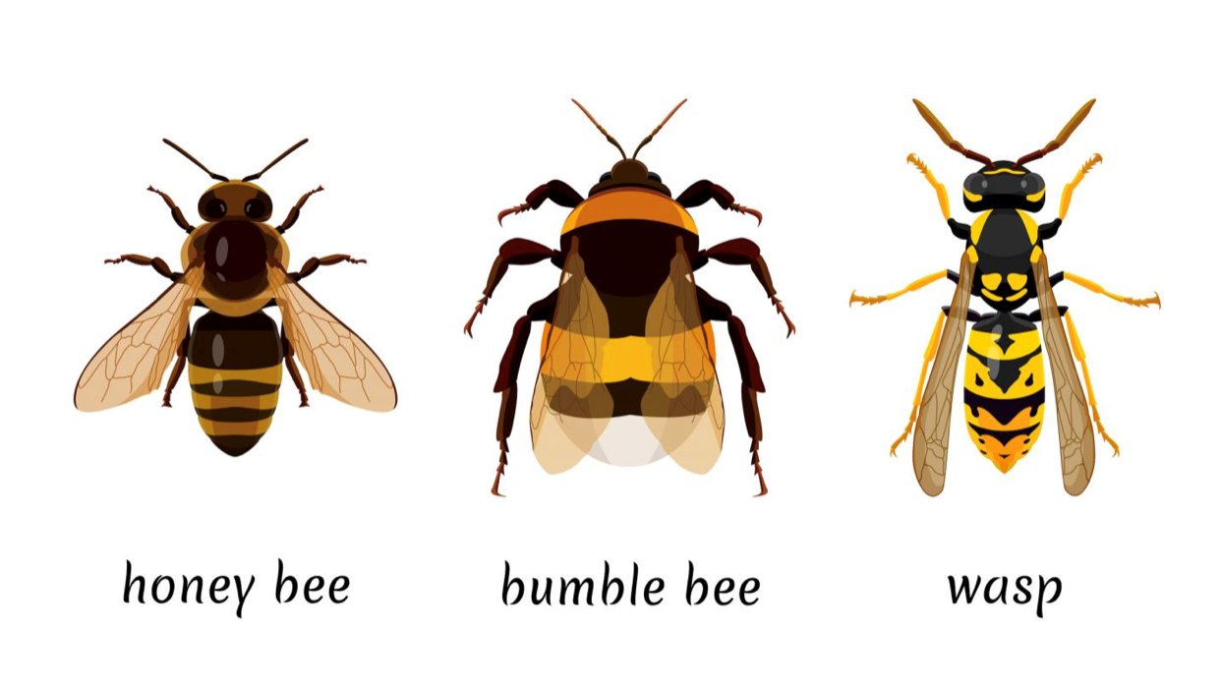
Stings
Honeybees
One and done
Remove the stinger! (Correctly)
Bumblebees, Wasps, Yellow Jackets, and Hornets.
Stings multiple times
As listed above: least aggressive to more aggressive
Notes:
Honeybees, bumblebees, wasps, yellow jackets, and hornets are the typical type of stings we are mostly concerned about in this lesson. With each of these stings, you must consider an allergic reaction. Almost all insect venom has the ability to cause an allergic reaction, and monitoring the body's response to the venom becomes important.
A typical non allergic reaction includes localized pain , redness, and itching lasting 1 to 2 days. The body may not respond so well to the venom and experience what is known a anaphylaxis, or severe allergic reaction. If the person stung experiences symptoms other than a local reaction, such as: sneezing, hives, severe itching, swelling under the skin, patches of reddening skin, and, or, disorientation, a severe allergic reaction is most likely taking place. If this is the situation, you will need to enact the Emergency Response Procedures.
With honeybees it is imperative to remove the stinger and venom sac correctly, which we will cover in the next slide.
Bumblebees, wasps, yellow jackets, and hornets can sting multiple times, especially hornets. Careful consideration should be taken between multiple stings, and severe allergic reaction. Being stung three or four times may appear as allergic reaction, but instead is just multiple local reactions. Monitor the sting sights, if an allergic reaction does not occur within 30 minutes, chances are good, no reaction will occur. If a reaction does occur, activate the emergency response procedures. Most fatalities occur within the first 2 hours of an anaphylactic reaction.

Slide 11
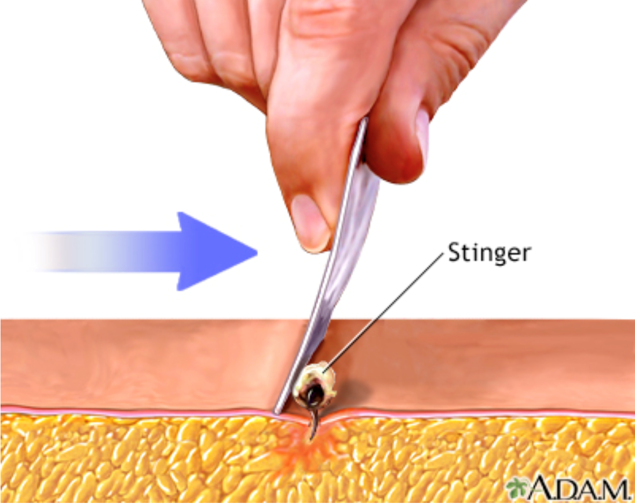
Stings and Stinger removal
If stinger and venom sac is still in place?
Do use a fingernail or rigid card in a scraping manner.
Do not use tweezers, or fingers in a pulling manner.
All Stings Treatment
Wash site with soap and water.
Apply cold pack to reduce pain and swelling.
Observe for anaphylactic reaction.
Notes:
When honey bees sting, their stinger stays within the skin because of the barbs on the stinger. The bee pulls away, tearing the venom sac and stinger off its own body, leaving the pulsating venom sac and stinger in the skin.
Using tweezers, or fingers can put pressure on the venom sac, and increase the amount of venom being delivered to the body. Scraping the stinger removes the stinger without putting pressure on the venom sac.

Slide 12
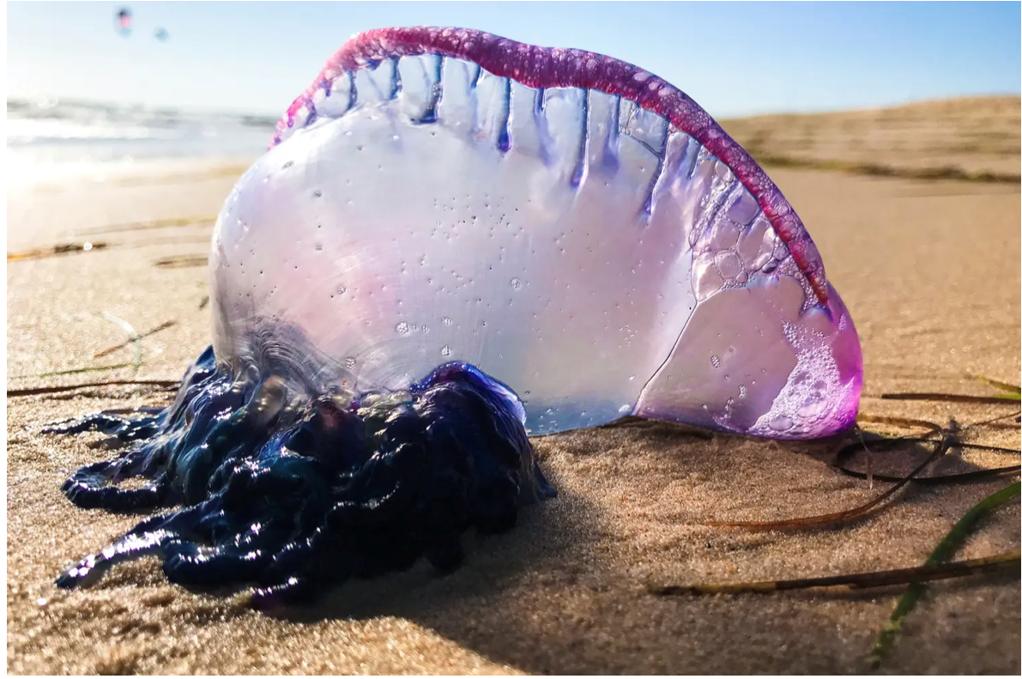
Jellyfish stings
Vary in intensity
Immediate pain.
Burn, prickling, stinging.
Throbbing pain that may radiate upwards if on limb.
Red, brown, or purplish track marks or “print”.
Irritated skin.
Itching or swelling.
Systemic illness.
Notes:
When a jelly fish graces you with its touch, thousands of microscopic barb unleash venom into your skin. Each stinger has a little bulb of venom that is activated upon touch.
Most symptoms that appear are listed on the slide. Systemic illness can appear immediately, or several hours later. These symptoms include stomach pain, headache, muscle pain or spasms, weakness, drowsiness, fainting , confusion, difficulty breathing, or heart problems. Life threatening symptoms are very rare, but can occur. If you or someone else is experiencing systemic symptoms, you will need to activate Emergency Response.
The severity of the reaction is dependent on the size and type of jelly, the patients age and size, how long stingers were exposed to skin, and the area of skin affected. Severe reactions are most likely to occur in children, and people in poor health.
Food for thought: Jelly fish can still sting when washed up on shore. So if you see a really cool inflated man-o-war washed up on shore, don’t touch it.

Slide 13
Jellyfish stings treatment
Prevention
Protective layer
Talk to the Life Guard about conditions
Avoid jellyfish season
If it does happen
Remove stingers
Flush with vinegar, or isopropyl alcohol, or sea water.
Notes:
Prevention will help, it usually always does. Observe the water, and if there is an abundance of jelly fish present in the water, it probably not a good idea to go for a dip. Talk with the life guard about sightings, or simply look up when your area is expected to be inundated with jellies because of seasonal patterns.
If contact does occur, remove the stingers with a gloved hand, tool or other means. Avoid touching the tentacles with the bare skin, because well its going to get stung too. Once the are is dried, you could use tape to remove more of the potentially imbedded stingers, or a plastic card to scrape the skin gently.
Flush with vinegar, if no vinegar, flush with isopropyl alcohol, not just any alcohol. If those two are not available consider the use of good ole ….. Yep you guessed it sea water. What, you thought I was going to say that thing. There's really no proof “that” actually works. Being stung by a jelly is already a bad day. Adding what your thinking makes it a terrible day. Remember, we are trying not to do more harm.
Once the stingers are out, and the situation is sorted, monitor for any systemic reactions, and apply a OTC Hydrocortisone, or Calamine lotion. Ice packs, or hot water also help with the pain.

Slide 14
Bites
Spiders
Identification is key.
Black Widow – About 1” in length, black with a distinctive hourglass shape on the abdomen.
Brown recluse – Light brown, with a dark brown violin-shaped mark on its back.
Notes:
So many spiders to choose from, and all of them are terrifying. Most do not cause injury, or serious complications, but our two next guest are not like most. The Black Widow, and Brown Recluse. Descriptions are mentioned in the slide.
Both spiders prefer dark, out-of-the-way places. Because of this, bites usually occur on the hands or arms of individuals reaching into the spiders hiding spot.
All to often the bitten person does not even realize they have been bitten until symptoms begin to show. Which we will cover… now.

Slide 15
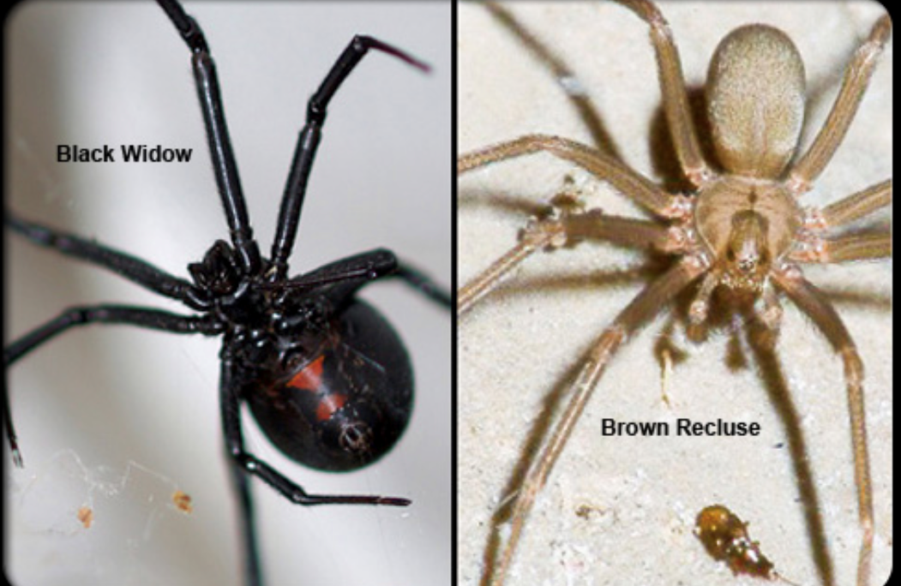
Spider Bite Symptoms
Black Widow – Swelling and dull pain at the injection site.
Nausea
Vomiting
Rigid or board like abdomen
Fever
Rash
Difficulty breathing and swallowing
Notes:
The venom of the Black Widow is toxic to the central nervous system. The central nervous system is the system in charge of taking in sensory information, processing information, and the sending out of motor signals.
Although the symptoms mentioned are severe, they are usually not fatal. An antivenin is available, but because of the side affects of the treatment, it is usually reserved for those with a heightened reaction, such as the elderly or children under the age of 5.

Slide 16
Spider Bites Symptoms
Brown Recluse
Local tenderness
Redness at injection site
Swelling
Difficulty breathing
Difficulty swallowing
Notes:
The bite of brown recluse creates more of a severe local reaction. After the bite and delayed by several hours or days the first symptoms are felt as a burning itching area of redness. A deep blue or purple area around the bite will develop with a surrounding whitish ring, outside of that ring a reddish one may appear. A blister, or an ulcer develops that eventually turns black. Headache, or bodyaches can occur, along with a fever or rash. Vomiting is rare, but possible.
Difficulty breathing, and swallowing seldom occur, but are worth mentioning.
Regardless, treatment for both are similar, and are included in our next slide.

Slide 17
Spider Bite Treatments
Wash the wound with soap and water
Apply a cold pack to the affected area
Activate Emergency Procedure if a severe reaction takes place.
Consider seeking medical attention if bitten by a Black Widow or Brown Recluse
Notes:
Because varying reactions can occur. Careful consideration should be used to identify what is a local reaction, versus what is a systemic or non local reaction. For instance redness or tenderness at the bite site would be considered local, while a bite on the arm that elicits pain or tenderness in the abdomen could be considered systemic.

Slide 18
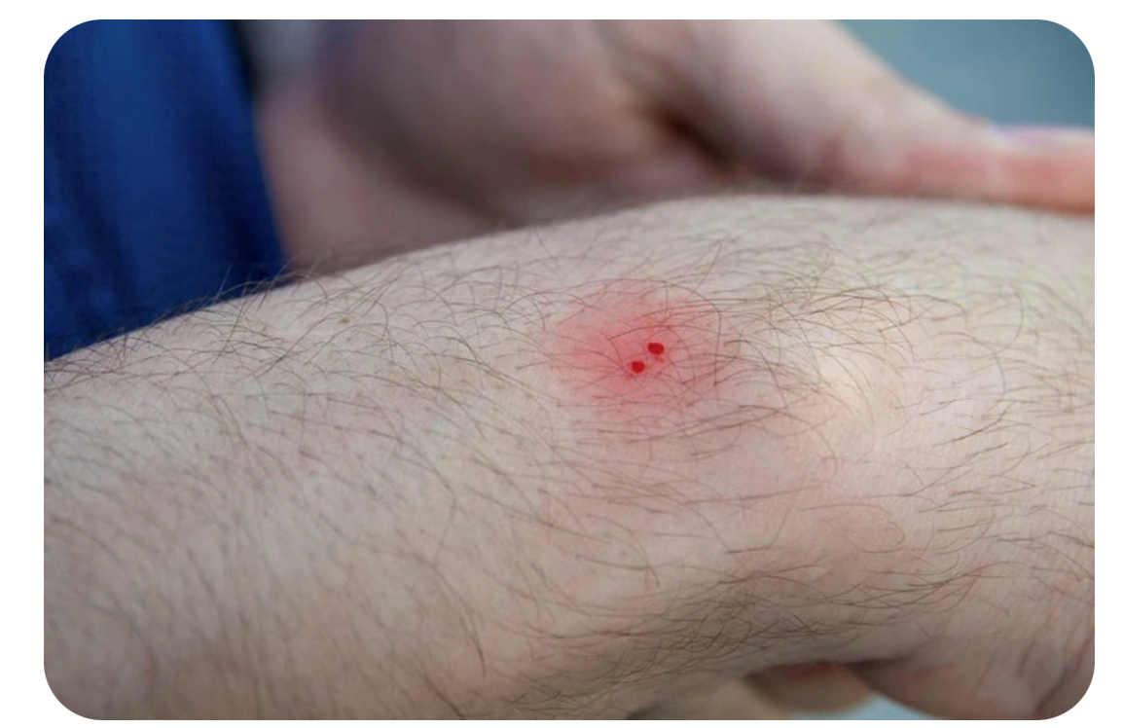
Bites
Snake Bites
Identity is crucial.
Most snake bites occur near the home.
Any unidentified snake bite should be considered poisonous.
Signs and Symptoms
Puncture marks
Pain and swelling
Rapid pulse
Nausea
Vomiting
Unconsciousness
Convulsions
Notes:
Snake bites kill very few people each year. Out of 45,000 bites each year, only 7,000 are bites of a snake that are poisonous. Of those 7,000 bites, only 15 or so deaths occur.
The United States has several poisonous snakes, and these lovely creatures are named the cottonmouth, rattle snake, copperhead, and coral snakes.
Zoos, laboratories, exotic pet stores, and individuals may own different types of snakes not commonly found in the wilds of the U.S.A.
Rattlesnakes account for the most snake bites, and nearly all fatalities from snake bites in the U.S.
If possible and safe, obtain a picture of the snake, or a good description. If the snake was killed, alert the EMS responders to the location for identification. EMS may transport the snake as well.
Do take a picture for identification if it is safe to do so.
If you do take a photo, don’t immediately post it on the Instagram, you’ve got a snake bite to deal with.

Slide 19
Snake Bite Treatment
Wash the bite area with soap and water.
Immobilize the injured part.
Position the part below the level of the heart.
Remove rings or jewelry on the affected limb.
Activate Emergency Response.
Alert Responders of the snake’s last known location for potential identification.
Notes:
Avoid applying ice or a cold pack to a snake bite. Ice or a cold pack may block circulation to the site.
Avoid applying a tourniquet. Tourniquets will constrict blood flow.
I know, I know. Your question might be, but wouldn’t we want to restrict blood flow to prevent the spread of venom? Yeah, but no. Keeping the venom concentrated will kill cells, and tissue, allowing it to flow, dilutes it in the body. We are alerting Emergency Response to counter this dilution.
Avoid suction of the wound. Your mouth is dirty, and can introduce germs.
Avoid cutting the bite area to let it bleed out... Even saying that out loud, doesn’t sound right.
Try not to cause anymore harm, that's a good general rule.
Avoid having alcohol, or caffeine if bitten by a snake. These beverages will help the venom spread faster throughout the body.

Slide 20
Animal Bites
1 -2 million dog bites annually.
400,000 cat bites annually.
Rabies are a concern
skunks
Bats
Raccoons
And so many more
Notes:
The statistics listed above are an estimation. Most people who are bitten from an animal never report it.
Bites range in severity from minor to serious, and sometimes are fatal.
Fatal bites are serious, but are rare. A serious type of bite is one from an animal with rabies.
Rabies is a virus that is transmitted through the saliva of an infected animal. If left untreated, rabies is fatal. Animals with a higher probability of having rabies are included on the slide. In addition to those cats, dogs, cows, and foxes are some others
Other animals that may carry the virus on rare occasions are hamsters, gerbils, guinea pigs, chipmunks, rats, mice, gophers, and rabbits. Your chances of catching rabies from a cow is greater than catching it from a gopher. If you’ve ever been bitten by a cow, and a gopher you’ve got a story or stories to tell.
If you suspect anyone, or yourself has been bitten by an animal with rabies, obtain medical care. A rabies vaccine which produces antibodies will be administered.

Slide 21
Animal Bites Treatment
Minor Animal Bites
Wash, apply antibiotic ointment, and cover with sterile dressing.
Serious Bite
Control bleeding, avoid cleaning if it may cause more bleeding, consider EMS
All Bites
Consider rabies
Identification
Notes:
With minor bites, you want to wash the wound with soap and water. Apply an antibiotic ointment and dry sterile dressing, and ensure medical is seen to prevent any infection.
If it is a serious bite, and bleeding is heavy, control the bleed first. Remember pressure, and elevation. Avoid cleaning if it is excessively bleeding to avoid more blood loss. If serious enough start the emergency response procedure, regardless this person needs to see medical for further evaluation.
With all bites, consider rabies, if you suspect it, relay it to the proper authorities. Try to remember or ask what the animal looked like, and where it was last seen.

Slide 22
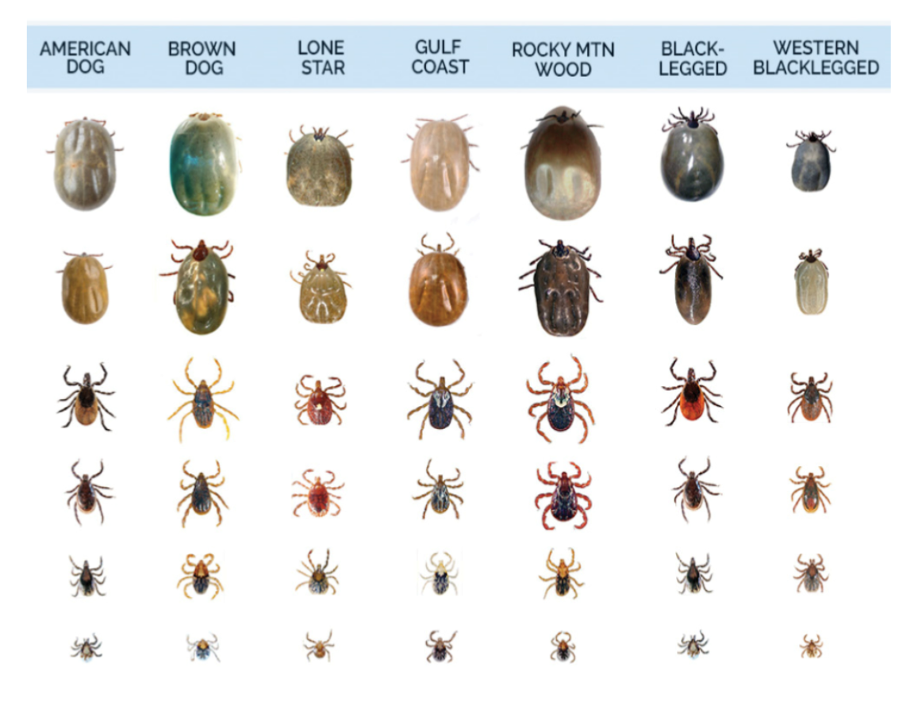
Tick Bites
Lyme disease
Rocky mountain spotted fever
Anaplasmosis
Babesiosis
Powassan Virus Disease
Notes:
I don’t like this slide. I feel them on me now.
Ticks are everywhere, they are direct descendants from everything bad. From the coastal crags of Maine, Whimsical woods of the south east, lush lake lands of Americas bread basket, and now they are even in saltwater sawgrass of the California coast.
90 species or so of ticks exist in the United States. Ticks of concern are the are the Lone Star Tick, which contrary to poplar belief, exist outside the lone star state. The Deer tick, American dog tick, Rocky Mountain Wood Tick, and the Brown Dog Tick.
Different diseases are carried by different ticks, and different regions of the U.S. have different ticks that carry those different diseases. When traveling to a new area, become familiar with what is the most common tick, and illness in the region. And remember if your on vacation and you get bitten by a tick. It may take weeks for symptoms to show from a tick borne illness to occur. By then you may have traveled back to your home, many miles away, and those types of illness are not regularly seen. Assist your medical provider, and give a thorough history.

Slide 23
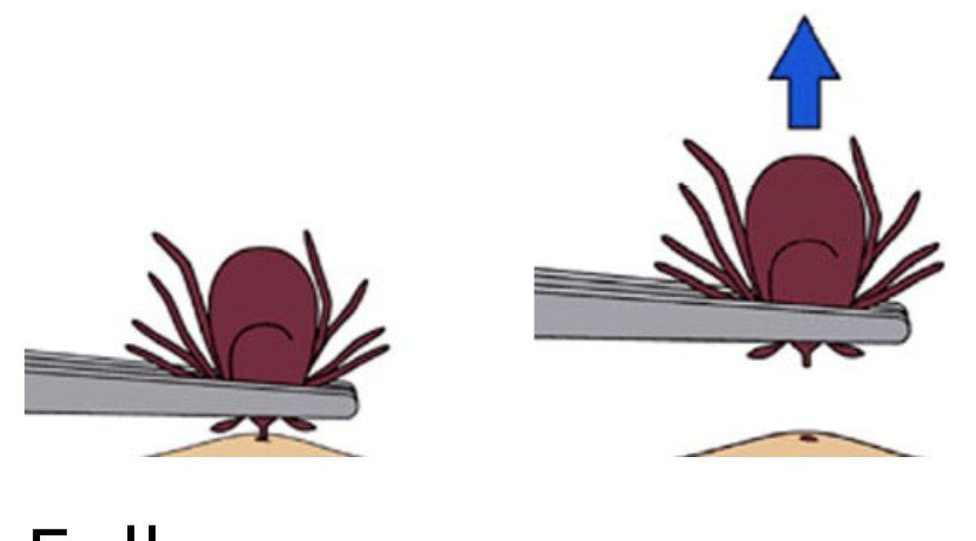
Tick removal
The do’s
Tweezer
Specialty tick removal
The don’ts
Vaseline
Gasoline
Match
Nail polish
Notes:
Use tweezers and get as close to the skin as possible, grasping the head of the tick pull straight up, remember to pull gently but also steadily. Dispose of the tick in appropriate ways. I use fire, I use lots of it. Other ways include a plastic bag with alcohol, you could flush the tick down the toilet (I wouldn’t recommend it if you have gas stove of fireplace). You could also simply liberate it, as well.
Avoid using the items to mentioned in our don’t column. Using these items will only irritate the tick causing it to burrow deeper in the skin. Irritating the tick can also encourage it to regurgitate the contents in its stomach into the body.
Diseases that ticks carry, normally reside in the stomach or saliva. Removing a tick is important, but removing properly is more important. Diseases generally take a bit of time to pass from the tick to the body, for instance Lyme disease takes about 24 hours to pass from the black legged ticks gut to the new host.
Make sure you grasp the head with the forceps. If you don’t get the head, and only the body, it will cause the tick to burrow deeper, and may cause infection.
Quick tip on Lyme disease. That bulls eye rash you always hear about. It doesn’t always happen. Only about 20 percent of cases have the rash. If you are concerned about tick disease, it may be possible to send the tick in for studying to see if it was infected. A quick web search will provide results, dependent on what state you reside. Please know, just because the tick comes back with something, doesn’t mean you have that something. It takes time to get that something from the tick, and the tick may not have been attached long enough.

Slide 24
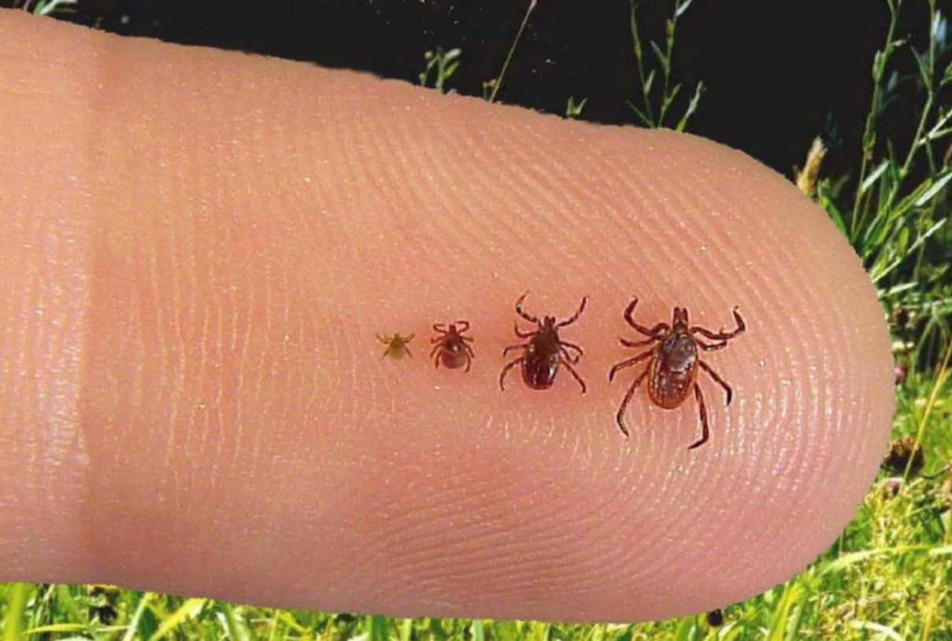
Tick avoidance
Keep yard mowed
Stay out of tall grass
Pants in socks
Permethrin
Tick check
Notes:
The best way to avoid a tick bite, it to avoid ticks. Unless you own a flock of fowl, who have ben trained to seek out ticks and eat them, your best bet is to follow the tips on the slide.
Keep grass mowed, ticks love to hang out on the ends of tall grass and pounce on their victim. Short grass make them more vulnerable to their prey.
If there is tall grass, try to stay on a path, avoid the hip high grass as much as possible.
If you got to go through he grass, create a solid barrier, tuck you shirt in, and put your pants in your socks, or you tall boots. This creates lass pathways for the tick to travel from outside the clothes to inside the cloths.
If you are heavily in the woods, consider a clothing treatment. Some of these contain a chemical called permethrin. It’s a substance you spray on your clothes and stays there for 20-30 washes.
Regardless of the method or methods used, always perform a tick check.

Slide 25
Allergic Reaction
Allergy – Abnormal sensitivity of the body's immune system to a substance.
Reactions to allergens.
Sneezing
Watery eyes
Runny nose
Red itchy rash (Contact Dermatitis)
Eczema
Asthma
Hives (Urticaria)
Notes:
As the slide mentions, an allergic reaction is a response of the body’s immune system to a substance that is usually deemed harmless. Almost any substance in the environment can be an allergen. Common allergens include; mold, pollen, dust, animal dander, latex, dyes, soaps, cosmetics, certain foods, or medications, and venom from insect stings.
Reactions to allergens also vary, some reactions are felt yearly, such as seasonal allergies, or hay fever. Some reactions are more severe.
Contact dermatitis, is usually caused by a substance that came in direct contact with the skin. The rash tends to swell, ooze, and scale, and generally occur only where the substance contacted the skin. Most common causes of this rash are poison ivy, poison oak, and sumac. Generally an over the counter calamine lotion will help with the itching, oozing, and discomfort of these types of plant reactions.
Eczema appears as a red, itchy rash with vesicles, or small blisters. Oozing, crusting, and scaling may also be present. These types of rashes are found more so in children in regards to allergic reaction, but can appear in adults as well. The rash appears on the face, neck, and folds of the elbow, and knee.
Allergic asthma is a more serious sign characterized by coughing, chest tightness, shortness of breath, and wheezing. The airway is constricting, and filling up with mucus, and should be treated seriously. While it can occur at anytime in the life span, it is more common in children and young adults. If left untreated it could lead to permanent lung damage, or worse. Those with known allergic asthma will usually be prescribed an inhaler for use. Those with unknown asthma will need to seek out medical care.
Uticaria is an outbreak on the skin consisting of welts of varying size, the welts are redder or paler than the surrounding skin. These welts are accompanied by intense itching.

Slide 26
Allergic Reaction
Food Allergy
Hives
Asthma
Nausea
Vomiting
Diarrhea
Abdominal pain
Swelling
Notes:
Allergic reactions to foods. They occur soon after eating a food the person is allergic too. The most common symptoms of a food allergy are listed in the slide.
Swelling of the lips, face, tongue, and throat are a serious sign, and should be treated quickly.
The primary treatment to food allergen is prevention of ingestion of that food.
With all allergy reactions, it is important to recognize a serious reaction from a “normal” reaction. Recognition will lead to an easier path. Most individuals who have experienced anaphylaxis will be carrying an epi pen for relief. Likewise, suffers from asthma will carry their own inhaler. If treatment is unavailable, and the person is having a serious reaction. Keep them calm, and seated ,and alert EMS. In extreme cases, CPR or rescue breathing may be needed if there is a loss of pulse, or breathing. It may be difficult to provide breaths, if the airway is swollen.
For less than severe reactions. An OTC Benadryl or other appropriate medication may be advisable. Be aware of the possible escalation of symptoms.

Slide 27
Allergic reaction tid-bits
House Dust
Millions, billions, trillions
Insect Stings
40 deaths per year
Penicillin
Notes:
House dust contains mites – these mites thrive in warm moist environments, and feed off dead skin that’s been shedded. Often found mostly on mattresses, carpets, stuffed animals, and upholstered furniture. If you are allergic to house dust, you are actually allergic to the waste product of these mites. Food is not scarce when it comes to these mites. The average human sheds 1 gram of skin a day, and this is enough to feed thousands of mites for months. There may be over 5000 mites, on one gram of dust from your mattress. Sleep easy.
Insect Stings – Almost all insects whose venom can cause allergic reactions belong to the order of the hymenoptera. (our friends from an earlier slide) the bees, wasps, and others.
It is estimated that 1 out every 125 Americans are allergic to the venom of insect stings. Any generalized reaction, or non local reaction is likely an anaphylactic reaction, and should be addressed immediately.
Discovered in 1929, but not put to use until 1940, penicillin is a common cause of drug reactions. It is estimated that that 2 to 5 percent of the population is allergic to penicillin. The tricky part is, symptoms can be overlooked because of the condition for which penicillin was actually prescribed. Symptoms from the illness, may resemble symptoms from the allergic reaction to Penicillin. Symptoms can also be more serious and turn into a full anaphylactic response.
Oral administration of penicillin is safer than the injected kind. There have only been six reported deaths from oral penicillin reaction. 95% of injectable reactions occur within the first hour.

Slide 28
Seizures
Seizure specific trigger conditions
Epilepsy
Encephalitis
Head injury (recent or past)
High fever
Drug or alcohol abuse
Withdrawal
Pregnancy
Diabetes
Heatstroke
Notes:
Seizures are a sudden episode of involuntary muscular contractions and relaxation, often accompanied by changes in sensation, behavior, or level of conciseness.

Slide 29
Seizure Types
Partial
Most common type of seizure
Broken down even further as:
Simple
Twitching or jerking in one part of the body
Last less than one minute
Patient remains awake and is alert
Complex
Patients level of consciousness is affected
Little to no memory of the episode
Notes:
Seizures are classified as partial or generalized according to the location of the abnormal electrical activity in the brain.
Partial seizures occur in approximately 80% of those who have seizures.
Simple partial seizure symptoms are listed on the slide
Symptoms of a complex partial seizure include abnormal behavior such as confusion, a glassy stare, aimless wandering, lip smacking or chewing, and fidgeting with clothes. These seizures last from a few seconds to a minute or two.
A simple and complex partial seizure can progress into a generalized seizure, and we will go over that next.

Slide 30
Seizure types
Generalized
“Grand mal seizure”, or tonic-clonic seizure
Tonic – last 30 seconds
Clonic – last a few seconds to a minute
Postictal state – last 10 – 30 minutes
Notes:
A generalized seizure is when the abnormal electrical activity spreads through-out the entire brain. The best known type of generalized seizure is the tonic-clonic seizure mentioned in the slide. With this type of seizure, the patient exhibits tonic-clonic activity, followed by postictal state.
During the tonic phase the person suddenly looses consciousness, and exhibits rigid muscular contractions. This makes the body to appear in a odd from appositional standpoint. Respirations are inhibited, which can lead to blue lips. Loss of bladder or bowel control can result in self defecation, or urination.
The clonic phase which follows the tonic phase has the patient jerking about violently, and contraction of the jaw muscles. The contraction of the jaw may result in the lip or tongue being bitten.
The final stage of the seizure is the postictal state. During this phase the patient will express a depressed level of consciousness, disorientation, and often will have a headache. The patient will have little to no memory of the episode.
Feelings of confusion, and exhaustion can last for hours.
Some individuals whom are prone to seizures especially those with epilepsy have warnings, called auras. An aura is a sensation perceived by the person as something is about to happen. Examples include a strange taste or smell, sounds, twitch, feelings of dizziness, or anxiety.

Slide 31
Seizure Protection
Remove hazards
Do not restrain
Loosen restrictive clothing
Do not insert anything into the mouth
If person vomits
Gently roll them on their side to prevent aspiration
If phases last longer than a few minutes call EMS
Notes:
Frightening to witness, they are usually not as bad as they look. Most patients recover within a few minutes. The one exception to this is called status epilepticus. These are prolonged or come in rapid succession without full recovery of consciousness between them. Status epilepticus is a potentially life threatening situation that requires immediate medical care.
Protect the person from harm, remove sharp or hazardous items in their possession. Remove hazards in the immediate area that the person can come into contact with.
Restraining the person can seriously injure the muscles, bones or joints. Remember from the snake bite lesson, try not to do more harm.
Loosen ties, scarves, collars, or jewelry that may interfere with breathing
Inserting things into the mouth could damage the teeth or mount, it can also interfere with breathing. Inserting items in the mouth may also enact the gag reflex and causing aspiration of vomit.
If vomiting occurs on its own, gently roll the person on one side to clear the mouth.
Remember, the seizure is going to happen, and there's nothing that you can do bout it, unless you happen to be a paramedic, and carrying your gear with you, but for the rest of us, its going to happen, and our best treatment is protecting the person. If you witness the onset of the seizure try to keep time of the event. if several minutes pass without consciousness alert EMS. If the onset was unwitnessed by anyone, alert EMS.

Slide 32
Dehydration
Signs and symptoms
Flushed appearance.
Dry skin.
Decreased amount of urine.
Treatment
Prevention.
Replenish with fluids.
Replenish with snack.
Activate Emergency Response if victim is unable to drink or eat.
Notes:
The key to dehydration is prevention. Ensure that you are drinking plenty of fluids, and that those fluids are replacing electrolytes.
Juice concentrated is not recommended, but a water down sports drink, or diluted fruit juice will replace lost sugars.
A salty snack can replace lost salts.
If unable to tolerate fluids, or solids. Call EMS. These individuals will need fluid replenishment via IV.
The best way to re-hydrate is the oral route. The body absorbs what it needs faster, and rids the extra.
Coffee is not a good option for rehydration, nor are energy drinks. Avoid alcohol when dehydrated, even if the cocktail is mixed with fruit juice that’s diluted by ice.

Slide 33
Heat Injuries
Heat Cramps
Heat exhaustion
Heatstroke
Notes:
Heat cramps are the least serious of the three types of heat related injury
Heat Exhaustion is the most common heat-related injury.
Heatstroke is the least common, but most serious.

Slide 34
Heat Cramps
Signs and symptoms
Painful muscle spasms
Hot, sweaty skin
Weakness
Rapid pulse
Treatment
Removal of victim to cool environment
Rest
Replacement of fluids and electrolytes
Consider activating Emergency Response if symptoms do not improve after treatments are rendered.
Notes:
Heat cramps are most apt to occur when an individual is exercising, or working in a hot environment, and fails to replace lost fluids and electrolytes.
The signs and symptoms are a warning that the person is having a problem with the heat. If ignored, heat cramps can progress to a more serious condition.

Slide 35
Heat Exhaustion
Signs and Symptoms
Cold and clammy skin that is pale or gray
Profuse sweating
Headache
Nausea
Dizziness
Weakness
Diarrhea
Notes:
Heat exhaustion occurs most often in individuals involved in vigorous physical activity on a hot or humid day, such as athletes and or deck and engineer workers.
It can also occur in people who are wearing too much clothing on a hot humid day.

Slide 36
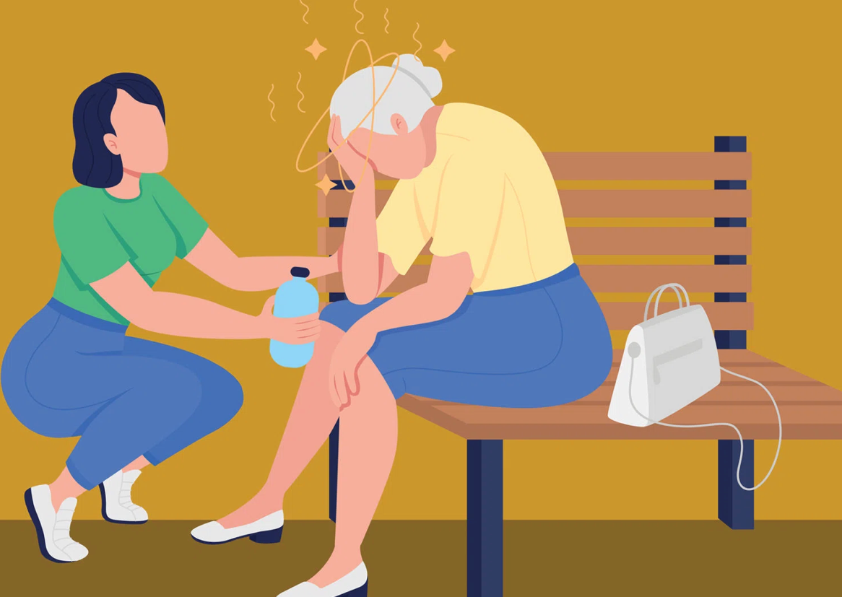
Heat Exhaustion
Treatment
Removal to cool environment
Replace fluids and electrolytes
Consider applying cool compress to forehead
Rest
Removal of extra clothing should be considered
Tight clothes should be loosened.
Notes:
In most cases, these measures are likely to improve the person’s status, however; if after 30 minutes of treatment occurs and there are no signs of improvement, or if symptoms worsen while treatments are being rendered, you will need to enact the emergency plan.

Slide 37
Heat Stroke
Signs and Symptoms
Body temperature of 105 or greater
Red, hot, and dry skin
Rapid and weak pulse
Dizziness / Weakness
Rapid and shallow breathing
Altered level of consciousness
Seizures
Notes:
During heat stroke, the body becomes so over heated the heat regulation system breaks down, and loses its ability to cool the body. Body heat rises to a temperature that begins to damage organs.
Heat stroke is most apt to occur in the elderly population during heat waves, or individuals who overexert themselves in a hot or humid environment.
Heat stroke can occur in a very short amount of time, especially in children.
All the mentioned topics today are preventable. Understandably accidents are bound to happen. We can still prevail as victorious if we can keep the accident from becoming a catastrophe.

Slide 38
In closing…
Protect yourself, but enjoy yourself
Hydrate
Sunscreen
Avoid spider hiding spots
Greet snakes from afar
Rest, reflect, and relax
Notes:
I would like to thank you for your time, and your attention., I would also like to wish everyone safe and productive summer.

Slide 39
References
Bonewit-West, KBW, (DEC-2017). Clinical Procedures for Medical Assistance. St. Louis MO. Elsevier Health Sciences.
DHS EMS Basic and Advanced Protocols (2020)

